Slide 1
Neopixel as HUD/OBDII Interface on Raspberry Pi
A continuing experiment in Car UI

Slide 2
Demonstration Design
Using Raspberry Pi and Fadecandy controller we connect an 8x8 Neopixel display for creating reflective HUD display.
The Neopixel board gives us 64 high brightness RGB pixels. Fadecandy gives us control and ability to dither with motion.

Slide 3
Demonstration Design cont...
The intent is to experiment on new and effective but non-distracting methods of providing automotive feedback that isn’t based on previous legacy methods.
HUD although not new is not paramount in commercial automotive yet.

Slide 4
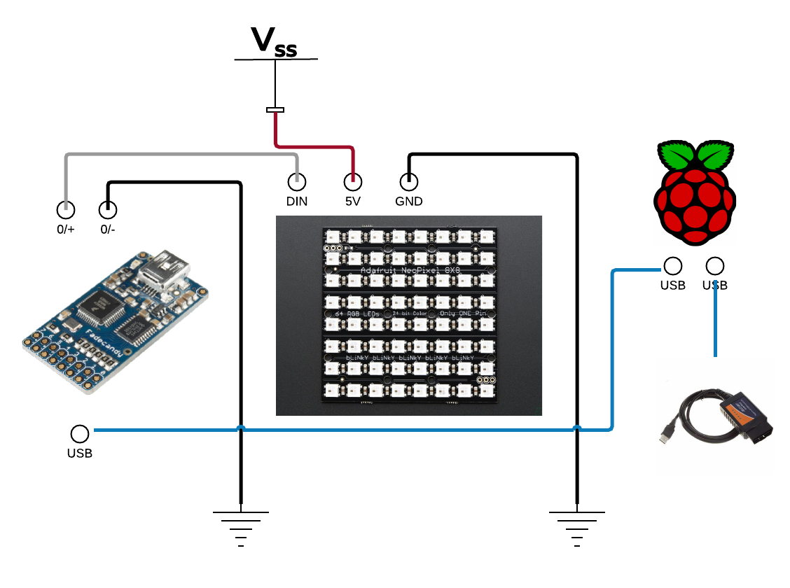
Demonstration Design cont...

Slide 5
Demonstration Design cont...
Initial phase is to construct usable interface with Neopixel.
We are using OpenPixelControl over IP to test and design our interface; since using python w/IP to rpi, we can simply move daemon to rpi once ready.

Slide 6
OpenPixelControl
https://github.com/zestyping/openpixelcontrol
Openpixelcontrol provides nice simple python library for talking to fcserver of Fadecandy. Controlling pixels directly with rpi is probably most desirable for final design, but this gives us simple to use interface to Neopixels not plagued by timing concerns.

Slide 7
Fadecandy setup
https://learn.adafruit.com/1500-neopixel-led-curtain-with-raspberry-pi-fadecandy/fadecandy-server-setup
Fadecandy gives us a robust and reliable interface to neopixel protocol. Arduino can handle a couple channels at best, but software controlled GPIO on rpi would not work well. There are alternatives for rpi using GPIO but not perfect yet.
https://learn.adafruit.com/neopixels-on-raspberry-pi/overview

Slide 8
Neopixel
https://learn.adafruit.com/category/led-matrix
Neopixel are individual IC/LED components.
Can be used in strips or matrices.
Controlled by daisy chain digital control bus.

Slide 9
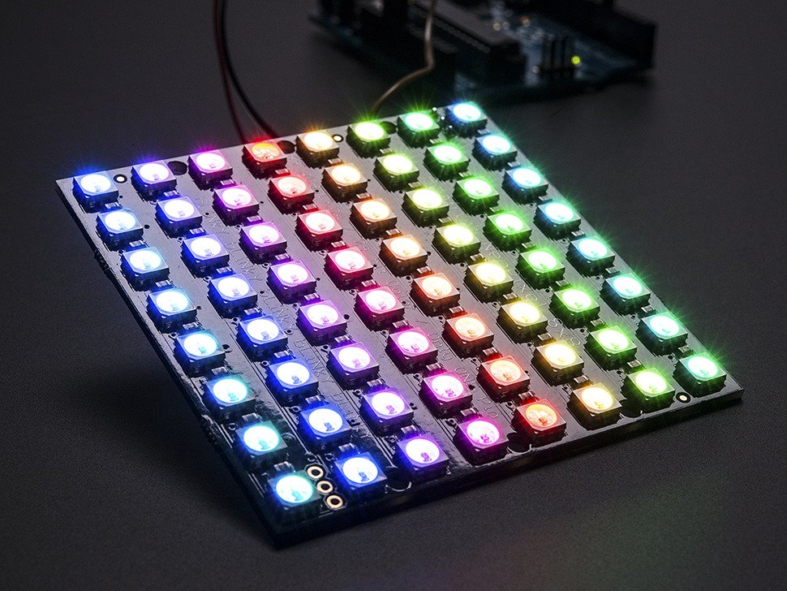
Neopixel cont...
We are using 8x8:
https://www.adafruit.com/product/1487
Power is from small 5v switching power supply from amazon.

Slide 10
OBDII
OBDII is used to get access to telemetry data from sensors and component throughout an automobile.
Since 1996 it has been mandatory to have accessible OBDII interfaces in US sold cars… different buses and standards have emerged since adoption. This includes European CAN Bus and other standards.

Slide 11
ELM327
Most common cheap OBDII adapters use the ELM327 chip or a knockoff. This processor supports many OBD bus types and offers a simplified interface to external devices that need access to the telemetry information.
Previously exclusively a serial device, the command structure is similar to previous modem or other style communication devices. ELM327 devices are now offered in USB, Bluetooth and WiFi models.

Slide 12
ELM327 cont...
Regardless of the communication standard you are using, the commands are generally the same.
Be aware not all OBDII/ELM327 devices are equal. Good to read reviews before you buy them:
http://www.amazon.com/gp/product/B00NGFWVNA/ref=s9_simh_gw_p422_d0_i1

Slide 13
Project in general
Quick look at code and demo.
Project on Github.
https://github.com/fwin-dev/RaspberryPi_Neopixel_HUD
To be continued...

